Slide 1

Significant Laurels of Mechanical Department

Slide 2
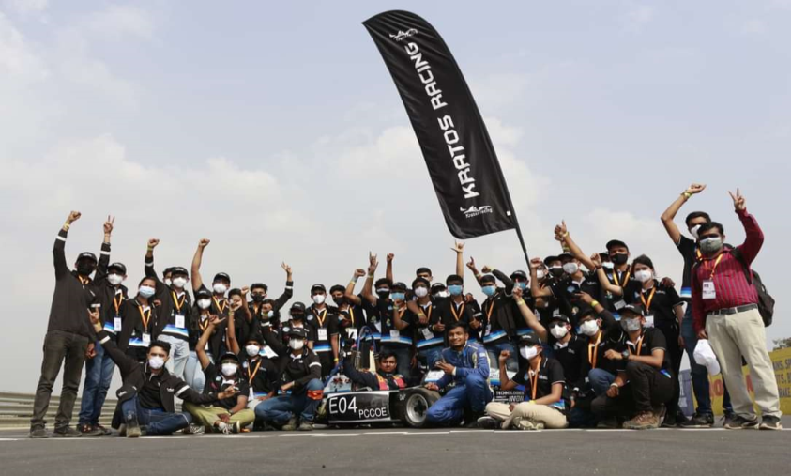
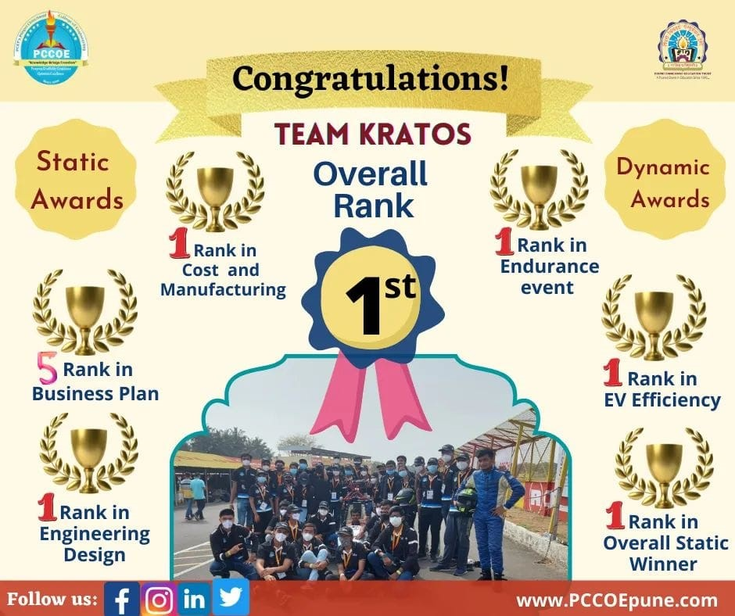
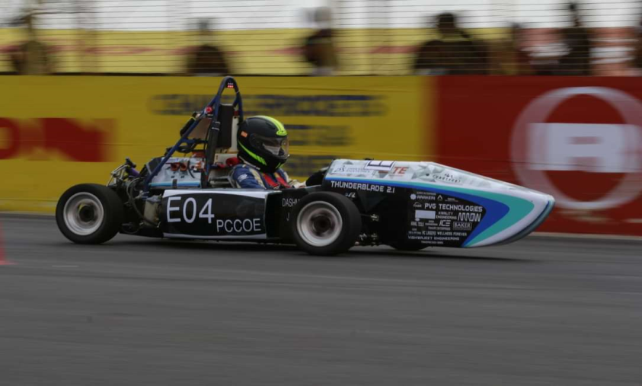
TEAM KRATOS- Formula Bharat 2022, Coimbatore

Slide 3

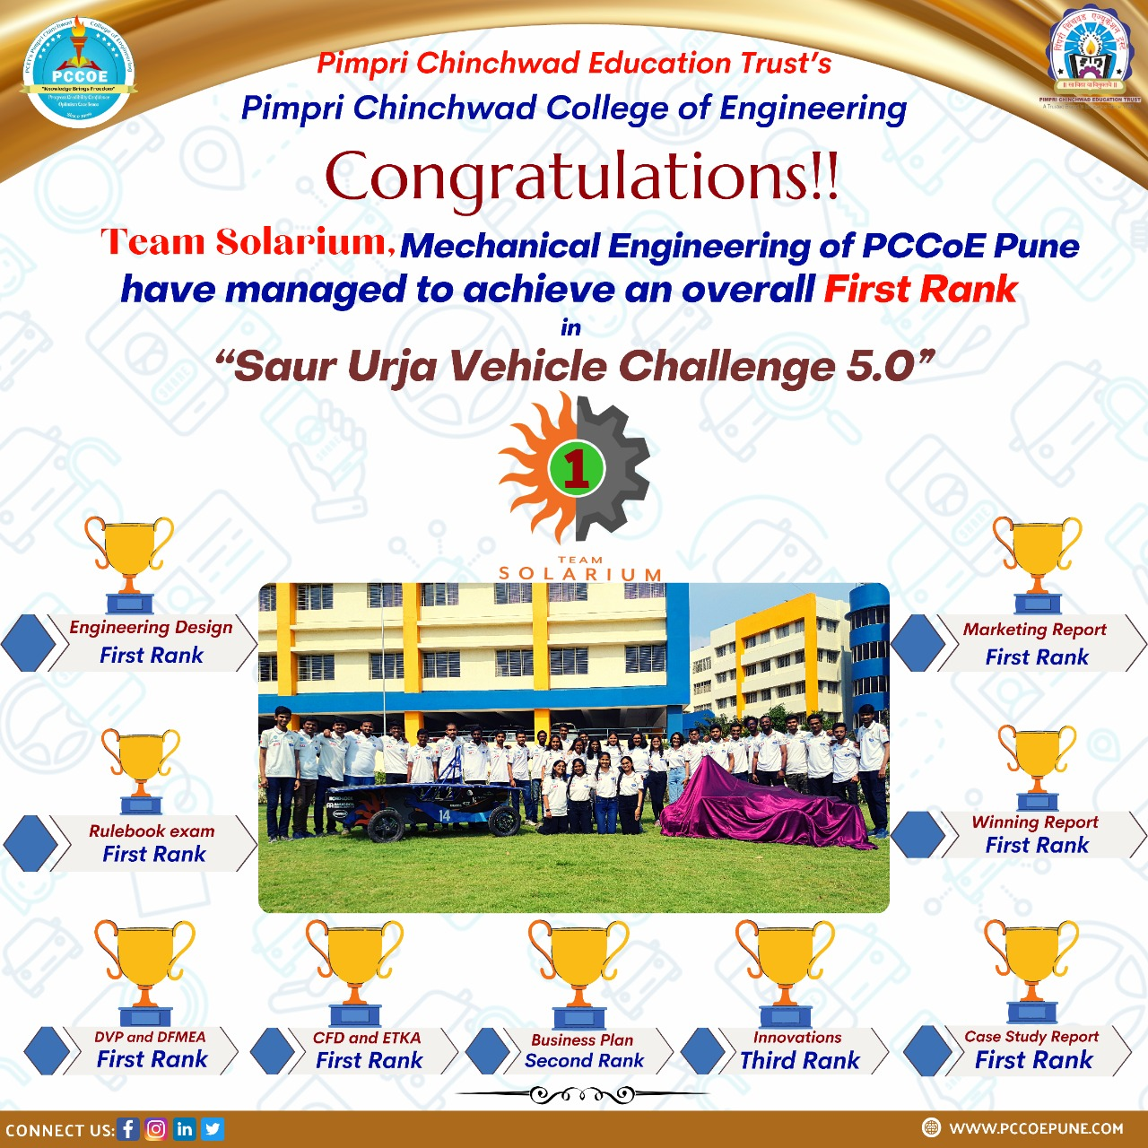
TEAM SOLARIUM- Saur Urja Vehicle Challenge 5.0

Slide 4
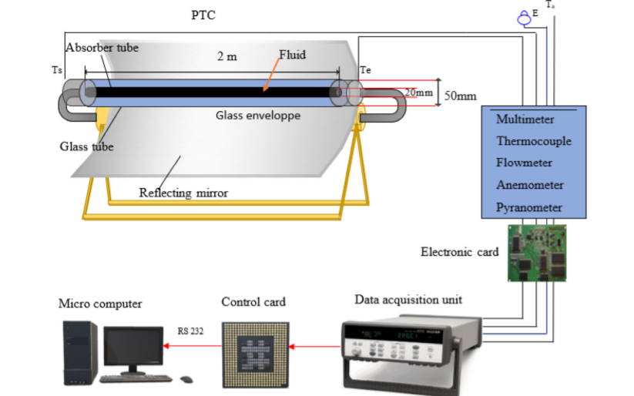
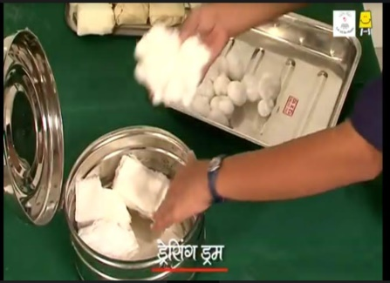
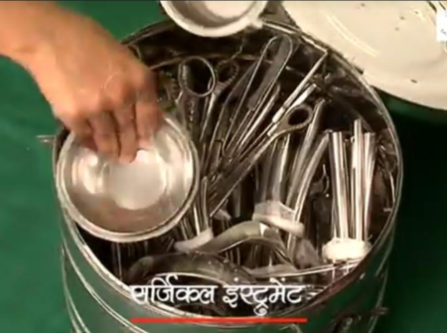
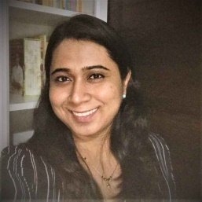
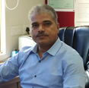
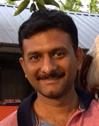
AICTE- Research Promotion Scheme
Title: Utilization of Green-clean energy source for the development of a novel hybrid line and point focused solar collector system for biomedical steam sterilization application.
Name of Investigators (Mechanical Dept):
Mrs. Gauri Phadtare;
Dr. P. A. Deshmukh.
Dr. Umesh Potdar,
Sanctioned Amount: 12,14,406/-
Funding agency: AICTE Quality Improvement Schemes (AQIS)
Duration: 3 years
Scheme: RPS (Research Promotion scheme)

